Slide 1
TREE

Slide 2
TREE
A tree is an abstract model of a hierarchical structure that consists of nodes with a parent-child relationship
Tree is a sequence of nodes
There is a starting node known as a root node
Every node other than the root has a parent node
Nodes may have any number of children

Slide 3

Nature View of a Tree
leaves
branches
root

Slide 4

Computer Scientist’s View
root
leaves
branches
nodes

Slide 5
In linear data structure, data is organized in sequential order and in non-linear data structure, data is organized in random order. Tree is a very popular data structure used in wide range of applications.

Slide 6
Tree data structure is a collection of data (Node) which is organized in hierarchical structure and this is a recursive definition

Slide 7
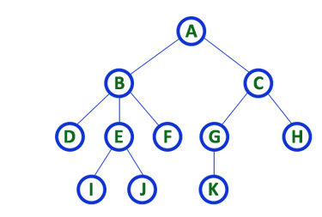
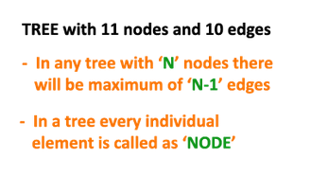
In tree data structure, every individual element is called as Node. Node in a tree data structure, stores the actual data of that particular element and link to next element in hierarchical structure. In a tree data structure, if we have N number of nodes then we can have a maximum of N-1 number of links.
Example

Slide 8
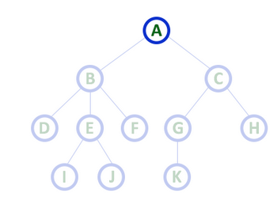
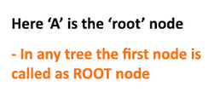
In a tree data structure, we use the following terminology...
ROOT
In a tree data structure, the first node is called as Root Node. Every tree must have root node. We can say that root node is the origin of tree data structure. In any tree, there must be only one root node. We never have multiple root nodes in a tree.

Slide 9
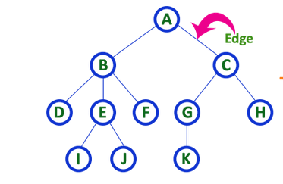

Edge
In a tree data structure, the connecting link between any two nodes is called as EDGE. In a tree with 'N' number of nodes there will be a maximum of 'N-1' number of edges.

Slide 10
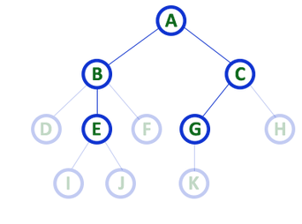
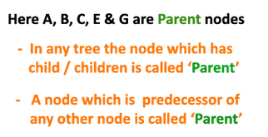
Parent
In a tree data structure, the node which is predecessor of any node is called as PARENT NODE. In simple words, the node which has branch from it to any other node is called as parent node. Parent node can also be defined as "The node which has child / children".

Slide 11
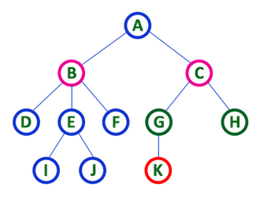
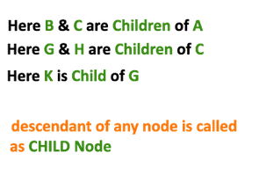
Child
In a tree data structure, the node which is descendant of any node is called as CHILD Node.
In simple words, the node which has a link from its parent node is called as child node. In a tree, any parent node can have any number of child nodes.
In a tree, all the nodes except root are child nodes.

Slide 12
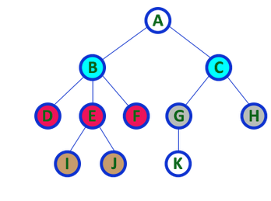
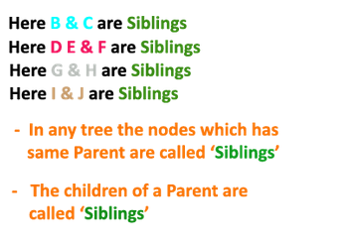
Siblings
In a tree data structure, nodes which belong to same Parent are called as SIBLINGS. In simple words, the nodes with same parent are called as Sibling nodes.

Slide 13
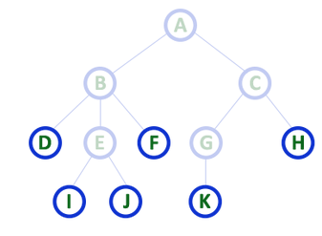
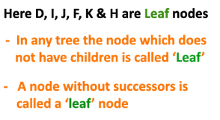
Leaf
In a tree data structure, the node which does not have a child is called as LEAF Node. In simple words, a leaf is a node with no child. In a tree data structure, the leaf nodes are also called as External Nodes. External node is also a node with no child. In a tree, leaf node is also called as 'Terminal' node.

Slide 14
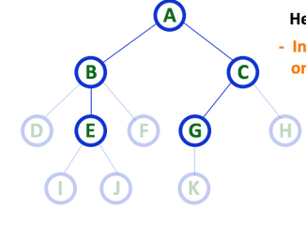
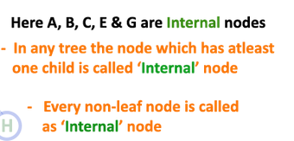
Internal Nodes
In a tree data structure, the node which has atleast one child is called as INTERNAL Node. In simple words, an internal node is a node with atleast one child. In a tree data structure, nodes other than leaf nodes are called as Internal Nodes. The root node is also said to be Internal Node if the tree has more than one node. Internal nodes are also called as 'Non-Terminal' nodes.

Slide 15
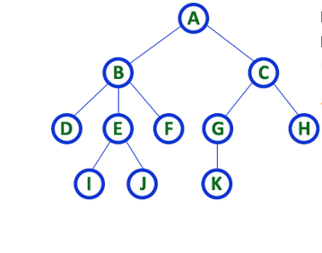
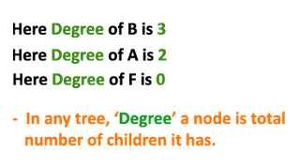
Degree
In a tree data structure, the total number of children of a node is called as DEGREE of that Node. In simple words, the Degree of a node is total number of children it has. The highest degree of a node among all the nodes in a tree is called as 'Degree of Tree'

Slide 16
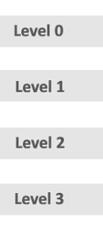
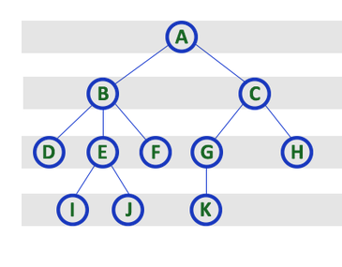
Level
In a tree data structure, the root node is said to be at Level 0 and the children of root node are at Level 1 and the children of the nodes which are at Level 1 will be at Level 2 and so on...
In simple words, in a tree each step from top to bottom is called as a Level and the Level count starts with '0' and incremented by one at each level (Step).

Slide 17
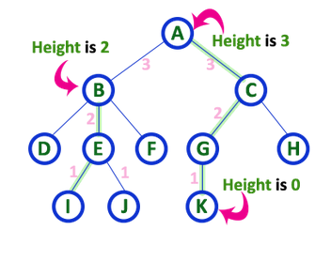
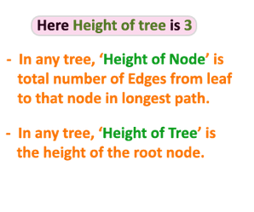
Height
In a tree data structure, the total number of egdes from leaf node to a particular node in the longest path is called as HEIGHT of that Node. In a tree, height of the root node is said to be height of the tree. In a tree, height of all leaf nodes is '0'.

Slide 18
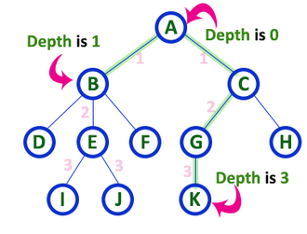
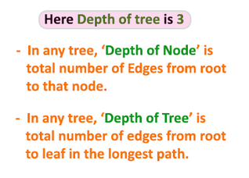
Depth
In a tree data structure, the total number of egdes from root node to a particular node is called as DEPTH of that Node. In a tree, the total number of edges from root node to a leaf node in the longest path is said to be Depth of the tree. In simple words, the highest depth of any leaf node in a tree is said to be depth of that tree. In a tree, depth of the root node is '0'.

Slide 19
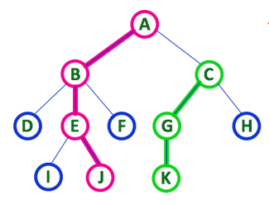
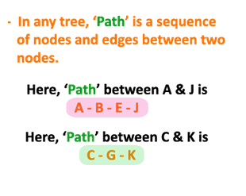
Path
In a tree data structure, the sequence of Nodes and Edges from one node to another node is called as PATH between that two Nodes. Length of a Path is total number of nodes in that path. In below example the path A - B - E - J has length 4.

Slide 20
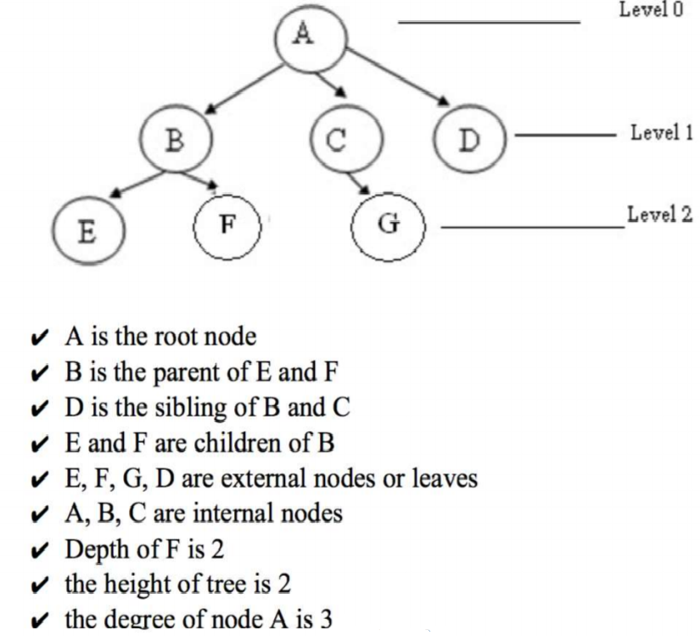
Tree Structure

Slide 21
Some Key Terms
Root − Node at the top of the tree is called root.
Parent − Any node except root node has one edge upward to a node called parent.
Child − Node below a given node connected by its edge downward is called its child node.
Sibling – Child of same node are called siblings.
Leaf − Node which does not have any child node is called leaf node.
Sub tree − Sub tree represents descendants of a node.
Levels − Level of a node represents the generation of a node. If root node is at level 0, then its next child node is at level 1, its grandchild is at level 2 and so on.
keys − Key represents a value of a node based on which a search operation is to be carried out for a node.

Slide 22
Cont…
Degree of a node:
The degree of a node is the number of children of that node
Degree of a Tree:
The degree of a tree is the maximum degree of nodes in a given tree
Path:
It is the sequence of consecutive edges from source node to destination node.
Height of a node:
The height of a node is the max path length form that node to a leaf node.
Height of a tree:
The height of a tree is the height of the root
Depth of a tree:
Depth of a tree is the max level of any leaf in the tree

Slide 23
Characteristics of Trees
Non-linear data structure
Combines advantages of an ordered array
Searching as fast as in ordered array
Insertion and deletion as fast as in linked list
Simple and fast

Slide 24
Applications
Directory structure of a file store
Structure of an arithmetic expressions
Used in almost every 3D video game to determine what objects need to be rendered
Used in almost every high-bandwidth router for storing router-tables
Used for indexing IP addresses.
Used in compression algorithms, such as those used by the .jpeg and .mp3 file formats

Slide 25
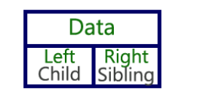
Left Child - Right Sibling Representation
In this representation, we use list with one type of node which consists of three fields namely Data field, Left child reference field and Right sibling reference field.
Data field stores the actual value of a node, left reference field stores the address of the left child and right reference field stores the address of the right sibling node. Graphical representation of that node is as follows...
If that node has right sibling then right reference field stores the address of right sibling node otherwise that field stores NULL.

Slide 26
Binary Tree
In a normal tree, every node can have any number of children. Binary tree is a special type of tree data structure in which every node can have a maximum of 2 children. One is known as left child and the other is known as right child.
A tree in which every node can have a maximum of two children is called as Binary Tree.

Slide 27
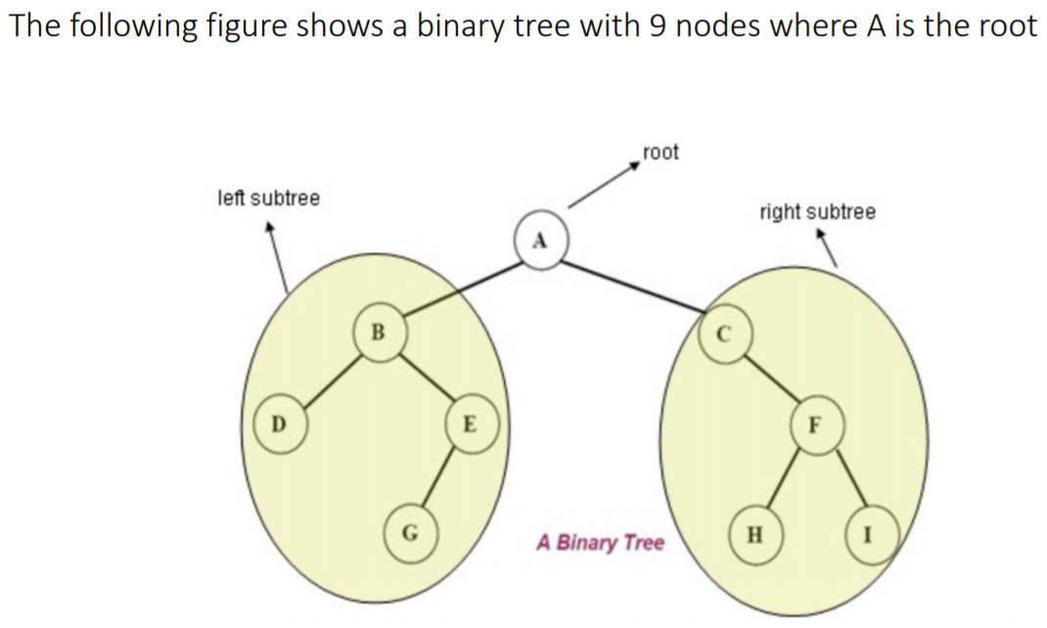
Cont…

Slide 28
Types of Binary Tree
Full Binary Tree/Strictly
Complete Binary Tree
Skewed Binary Tree
Perfect Binary Tree

Slide 29
Strictly Binary Tree
In a binary tree, every node can have a maximum of two children. But in strictly binary tree, every node should have exactly two children or none. That means every internal node must have exactly two children. A strictly Binary Tree can be defined as follows...
A binary tree in which every node has either two or zero number of children is called Strictly Binary Tree
Strictly binary tree is also called as Full Binary Tree or Proper Binary Tree or 2-Tree

Slide 30
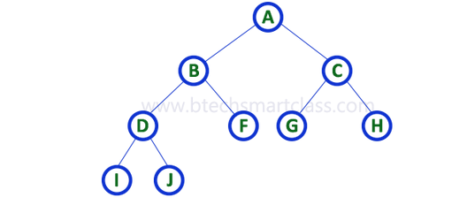

Slide 31
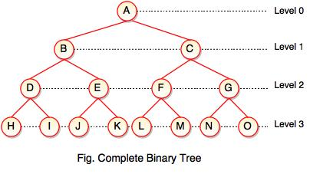
Complete Binary Tree
If all levels of tree are completely filled except the last level and the last level has all keys as left as possible, is said to be a Complete Binary Tree.
Complete binary tree is also called as Perfect Binary Tree.
In a complete binary tree, every internal node has exactly two children and all leaf nodes are at same level

Slide 32
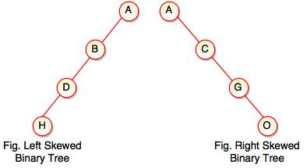
Skewed Binary Tree
If a tree which is dominated by left child node or right child node, is said to be a Skewed Binary Tree.
In a skewed binary tree, all nodes except one have only one child node. The remaining node has no child.
In a left skewed tree, most of the nodes have the left child without corresponding right child.
In a right skewed tree, most of the nodes have the right child without corresponding left child.

Slide 33
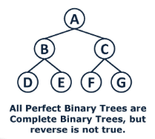
Perfect Binary Tree
A Binary tree is Perfect Binary Tree in which all internal nodes have two children and all leaves are at the same level.

Slide 34
C Representation for Binary Tree
typedef struct node *tree_pointer;
typedef struct node {
int data;
tree_pointer left_child, right_child;
};
data
left_child
data
right_child
left_child
right_child

Slide 35
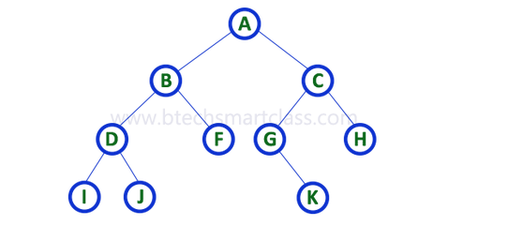
Binary Tree Representations

Slide 36
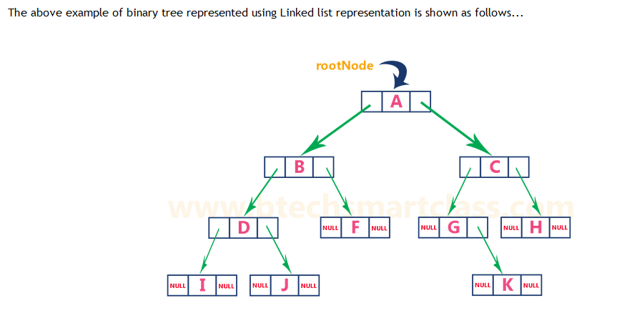

Slide 37
Binary Search Tree
A binary search tree is a binary tree in which all nodes in the left subtree of a node have lower values than the node. All nodes in the right subtree of a node have higher value than the node.
Search tree property
all keys in left subtree smaller than root’s key
all keys in right subtree larger than root’s key

Slide 38
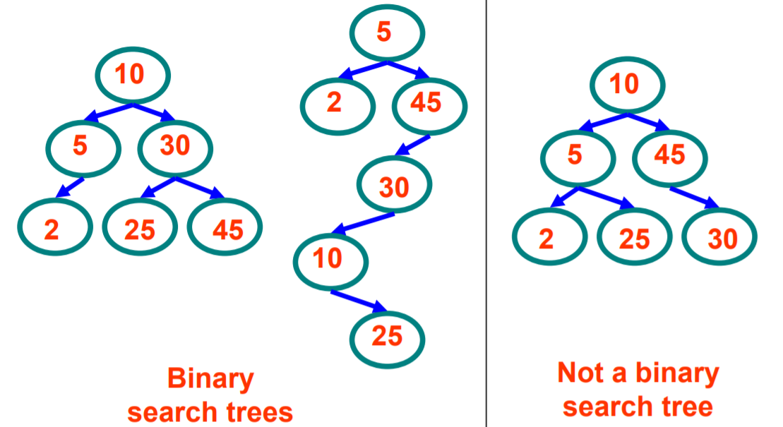
BST Example

Slide 39
Operations on BST
Insertion
Deletion
Search
Traversal

Slide 40
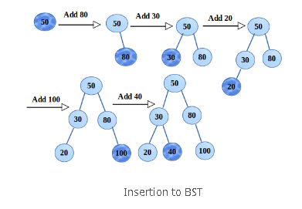
BST Insertion

Slide 41
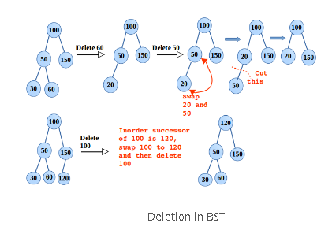
BST Deletion

Slide 42
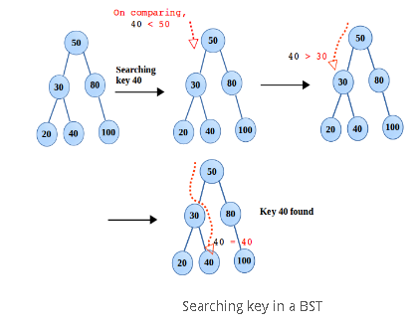
BST Search

Slide 43
BST Traversal
Let L, V, and R stand for moving left, visiting the node, and moving right.
There are six possible combinations of traversal
-LVR, LRV, VLR, VRL, RVL, RLV
Adopt convention that we traverse left before right, only 3 traversals remain
-LVR, LRV, VLR
-inorder, postorder, preorder

Slide 44
BST Traversal
Preorder Traversal
Postorder Traversal
Inorder Traversal

Slide 45
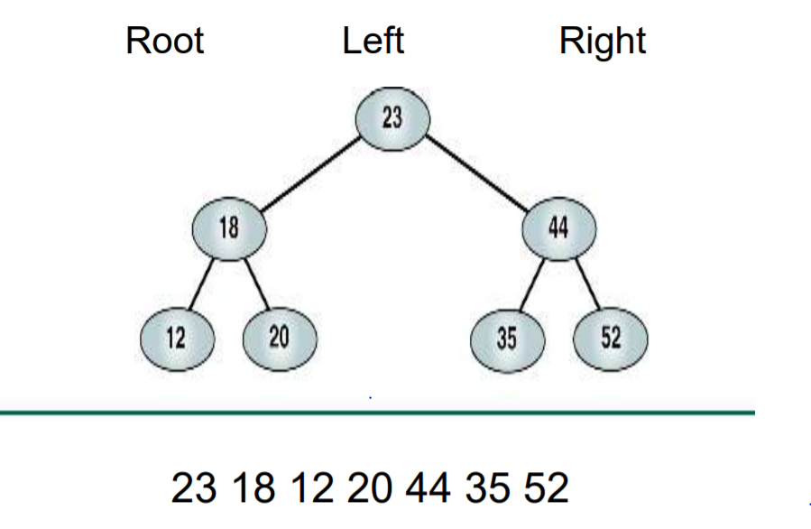
Preorder Traversal

Slide 46
Preorder Traversal
void preorder(tree_pointer ptr)
/* preorder tree traversal */
{
if (ptr) {
printf(“%d”, ptr->data);
preorder(ptr->left_child);
predorder(ptr->right_child);
}
}
+ * * / A B C D E

Slide 47
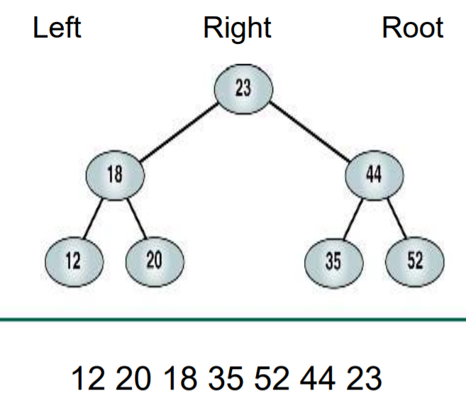
Postorder Traversal

Slide 48
Postorder Traversal
void postorder(tree_pointer ptr)
/* postorder tree traversal */
{
if (ptr) {
postorder(ptr->left_child);
postdorder(ptr->right_child);
printf(“%d”, ptr->data);
}
}
A B / C * D * E +

Slide 49
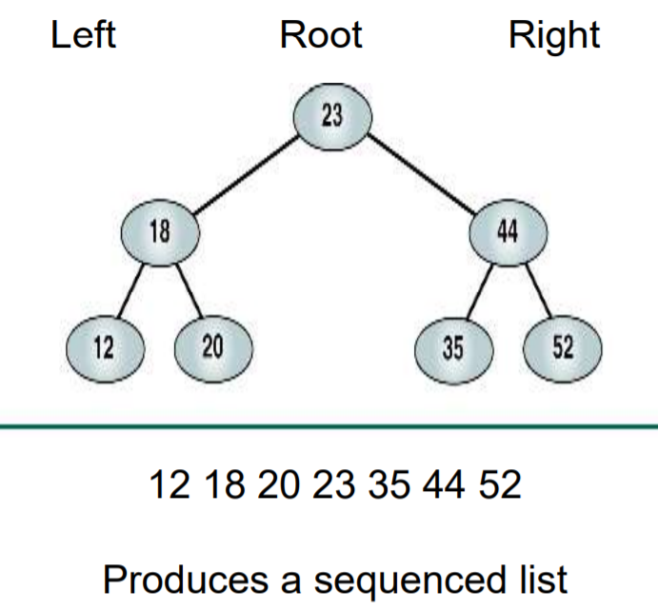
Inorder Traversal

Slide 50
Inorder Traversal
void inorder(tree_pointer ptr)
/* inorder tree traversal */
{
if (ptr) {
inorder(ptr->left_child);
printf(“%d”, ptr->data);
indorder(ptr->right_child);
}
}
A / B * C * D + E

Slide 51
Thank You

